Slide 1




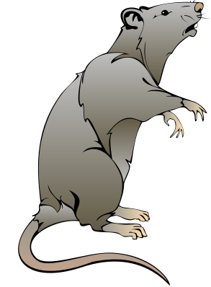
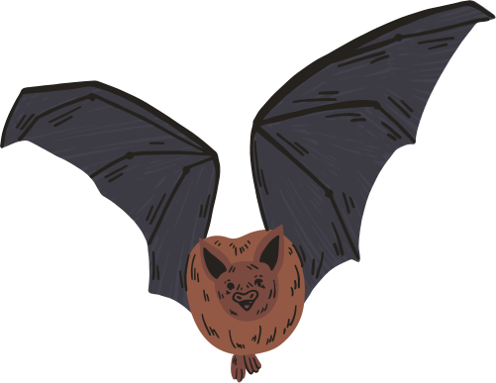
HIT140 ASSIGNMENT2
🦇 BAT VS. RAT: THE FORAGE FILES
INVESTIGATION A – DO BATS PERCEIVE RATS AS PREDATORS?
Group Members
AAKASH SHRESTHA_S384041
HADI RAHMAN MOHAMMED_S385676
ROCHAK BHUSAL_S384045
RUDRAKSH PATEL_S385718

Slide 2
BACKGROUND
BAT VS. RAT: THE FORAGE FILES
Egyptian Fruit Bats are nocturnal animals that rely heavily on fruit sources for food. However, Black Rats, which are also nocturnal, often invade the same feeding platforms.
This overlap in feeding times and spaces leads to frequent interactions between bats and rats. The key question for zoologists was: are these interactions simply competition over food, or do bats actually perceive rats as potential predators?
To investigate this, the research team conducted a 7-month observational study in a semi-natural bat colony, setting up food platforms and recording animal behaviour using surveillance cameras. The video footage was then carefully annotated to capture behavioural patterns such as risk-taking, avoidance, and foraging success.

Slide 3
INVESTIGATION AIM
The key question is whether bats perceive rats only as competitors or as predators. If bats see rats as predators, we should expect avoidance behaviours — being vigilant, delaying their landing, or retreating. If they see them as competitors, bats might instead take risks, challenging or ignoring the rats to secure food.

Slide 4
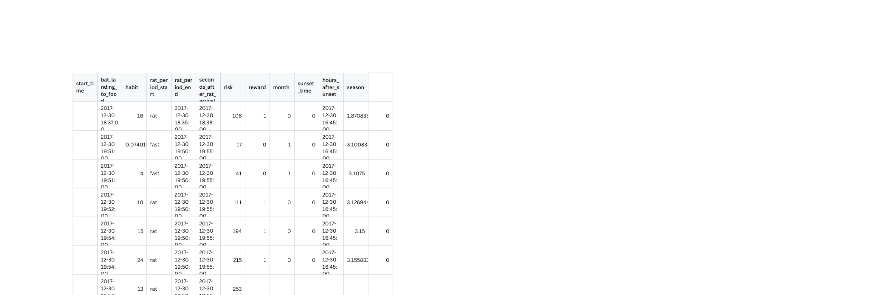

DATASET 1 OVERVIEW
The first dataset focuses on what happens each time a bat lands on a provisioned food platform when rats are present. Each row in this dataset is a unique, single bat landing on the food platform. It further describes the situational context and a bat’s observed behaviours following its landing. The zoologists manually detected each bat landings from the collected surveillance video footage, as previously described. Behavioural variables such as vigilance and foraging success of each landing were then manually annotated and quantified by watching the video recordings

Slide 5
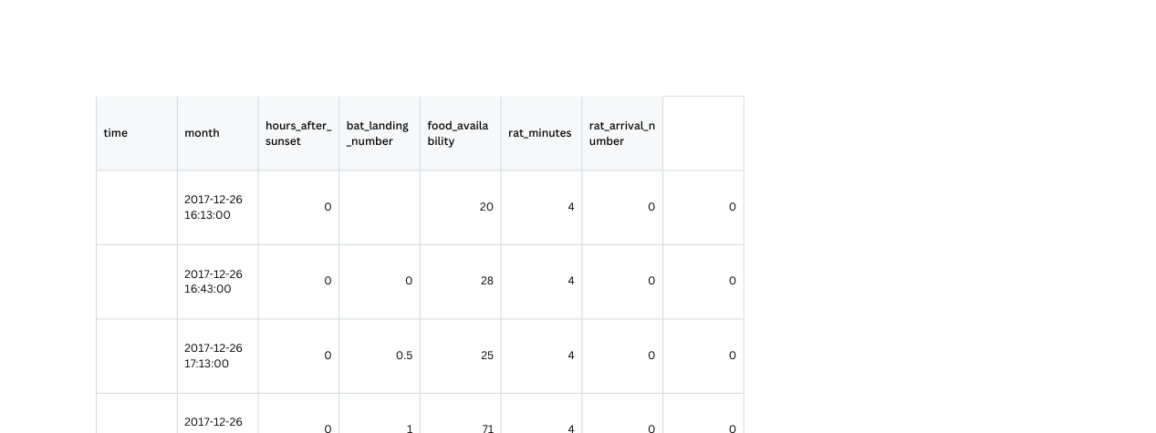
DATASET 2 OVERVIEW
The second dataset focuses on rats’ arrival events at the food platform. Each row in the dataset represents the outcome of a 30-minute continuous video surveillance recording of the same food platform as the one mentioned in dataset1.csv. The number of unique rat arrivals within each 30-minute interval was then manually counted from the recordings and aggregated. The dataset contains some other observations, such as the total number of bat landings and estimated food depletion in each period.

Slide 6
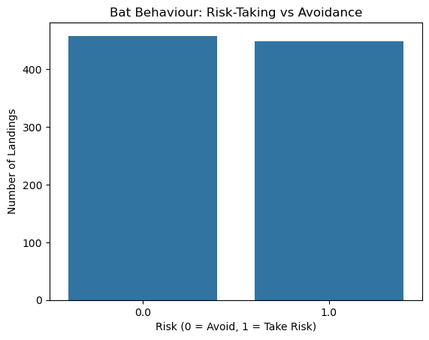
ANALYSIS
This chart compares how often bats were rewarded with food based on whether they took risks or not.
It helps us see if risk-taking actually increases the chance of getting food.

Slide 7
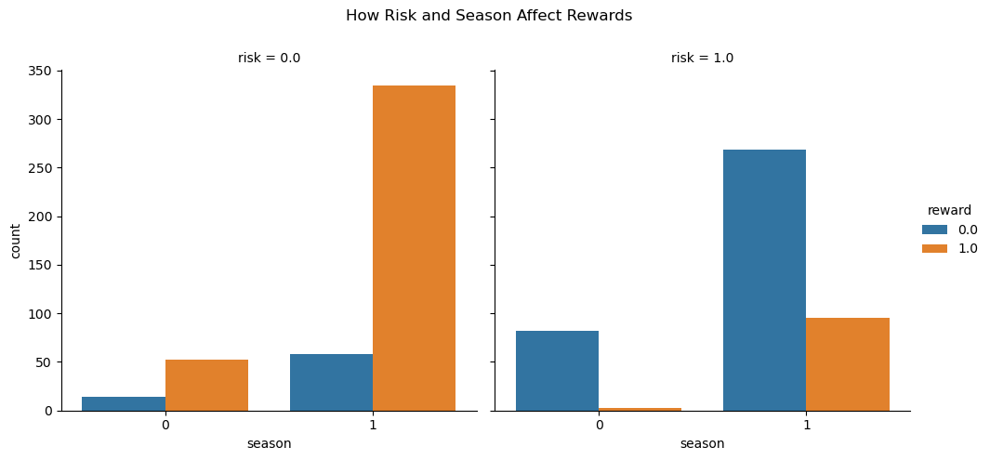
ANALYSIS
This heatmap shows how different numeric columns are related to each other.
It helps us find patterns or connections between timing, risk, reward, and other features.

Slide 8
OVERALL ANALYSIS & FINDINGS
The study explored bat risk-taking behaviour when rats were present, using visualizations of landing decisions, rewards, timing, and seasonal patterns.
Risk-taking vs Avoidance: Bats showed a clear split between bold and cautious strategies, indicating consistent behavioural differences.
Rewards & Outcomes: Risk-taking slightly increased chances of food rewards, but success was not guaranteed — showing a balance between boldness and caution.
Reaction Time: Risk-takers landed sooner after rat arrival, reflecting quicker and bolder decision-making, while avoiders delayed landings.
Seasonal Variation: Risk-taking behaviour changed across seasons, suggesting that environmental conditions and resource needs influence bat decisions.

Slide 9
THANK YOU

